Slide 1
Finite fields

Slide 2
Outline
[1] Fields
[2] Polynomial rings
[3] Structure of finite fields
[4] Minimal polynomials

Slide 3


[1] Fields
Definition 3.1.1: A field is a nonempty set F of elements with two operations “+” and “‧” satisfying the following axioms.
  (i) F is closed under + and ‧; i.e., a+b and a‧b are in F.
  (ii) Commutative laws: a+b=b+a, a‧b=b‧a
  (iii) Associative laws: (a+b)+c=a+(b+c) , (a‧b)‧c=a‧(b‧c)
  (iv) Distributive law: a‧(b+c) = a‧b + a‧c
  (v) (vi) Identity: a+0 = a , a‧1 = a for all a F. 0‧a = 0.
  (vii) Additive inverse: for all a F, there exists an additive inverse (-a) such that a+(-a)=0
  (viii) Multiplicative inverse: for all a F, a≠0, there exists a multiplicative inverse a⁻¹ such that a‧a⁻¹=1

Slide 4

[1] Fields
Lemma 3.1.3: F is a field.
  (i) (-1)．a = -a
  (ii) ab = 0 implies a =0 or b =0.
Proof:
  (i) (-1)．a + a = (-1)．a + 1．a = ((-1)+1)．a = 0．a =0
  Thus, (-1)．a = -a
  (ii) If a≠0, then b = 1*b = (a⁻¹a)b = a⁻¹(ab) = a⁻¹* 0 = 0.

Slide 5

[1] Fields
Definition:
  A field containing only finitely many elements is called a finite field.
  A set F satisfying axioms (i)-(vii) in Definition3.1.1 is called a (commutative) ring.
Example 3.1.4:
  Integer ring: The set of all integers Z={0, ±1, ±2, …} forms a ring under the normal addition and multiplication.
  The set of all polynomials over a field F, F[x] = {a₀+a₁x+…+a_{n}x^{n} | a_{i} F, n≧0} forms a ring under the normal addition and multiplication of polynomials.

Slide 6

[1] Fields
Definition 3.1.5: Let a, b and m>1 be integers. We say that a is congruent to b modulo m, written as
if m| (a - b); i.e., m divides a - b.
Remark 3.1.7: a = mq + b ,where b is uniquely determined by a and m. The integer b is called the (principal) remainder of a divided by m, denoted by
(a (mod m))

Slide 7
[1] Fields
Ring Z_{m} (or Z/(m)) is the set {0, 1, …, m-1} under addition and multiplication defined as follows
  + : a + b in Z_{m} = (a + b) mod m
  ．: a ．b in Z_{m} = ab mod m
Example 3.1.8:
  Z₂ is a ring also a field.
  Z₄ is a ring but not a field since 2⁻¹ does not exist.
Notes:
Check all the axioms (i)-(vii) in Definition 3.1.1

Slide 8

[1] Fields
Theorem 3.1.9 Z_{m} is a field if and only if m is a prime.
Proof:
  (➔)Suppose that m is a composite number and let m = ab for two integers 1< a, b< m. Thus, a≠0, b≠0. 0=m=ab in Z_{m}. This is a contradiction to Lemma 3.1.3. Hence Z_{m} is not a field.
  (⬅) If m is a prime. 0<a<m, a is prime to m. there exist two integers u,v such that ua +vm =1. ua≡1 (mod m). u =a⁻¹. This implies that axiom (viii) in Definition 3.1.1 is also satisfied and hence Z_{m} is a field.
Notes:
(←)Z_{m} is a ring. We only have to show that multiplicative inverse element exist.

Slide 9
[1] Fields
Definition 3.1.10:
Let F be a field. The characteristic of F is the least positive integer p such that p*1=0, where 1 is the multiplicative identity of F.
If no such p exists, we define the characteristic to be 0.
Example 3.1.11
  The characteristics of Q, R, C are 0.
  The characteristic of the field Z_{p} is p for any prime p.

Slide 10
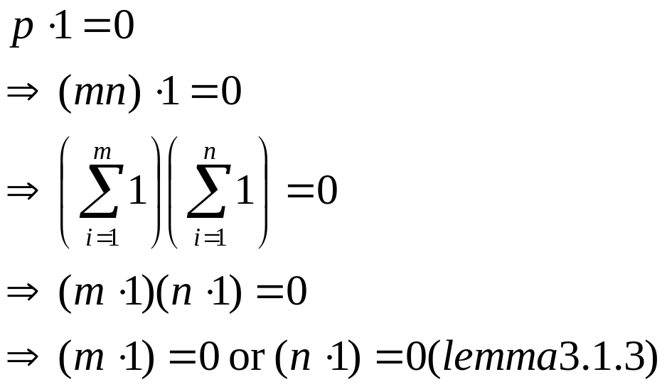
[1] Fields
Theorem 3.1.12: The characteristics of a field is either 0 or a prime number.
Proof: 1 is not the characteristic as 1*1≠0.
Suppose that the characteristic p of a field F is composite. Let p = m*n for 1<n, m < p.
This contradicts the definition of the characteristic.

Slide 11
[1] Fields
In abstract algebra a subfield is a subset of a field which, together with the additive and multiplicative operators restricted to it, is a field in its own right.
If K is a subfield of L, then L is said to be a field extension of K.

Slide 12
[1] Fields
Example 3.1.13:
  Q is a subfield of both R and C.
  R is a subfield of C.
  Let F be a field of characteristic p; then Z_{p} can be naturally viewed as a subfield of F.

Slide 13

[1] Fields
Theorem 3.1.14: A finite field F of characteristic p contains p^{n} elements for some integer n≧1.
Proof:
  Choose an element α₁ F*. We claim that 0‧α₁, 1‧α₁,…,(p-1)‧α₁ are pairwise distinct. If i‧α₁= j‧α₁ for some 0≦i ≦j ≦p-1, then (j - i) α₁= 0. Hence i = j .(∵characteristic of F is p)
  If F={0‧α₁, 1‧α₁,…,(p-1)‧α₁}, we are done.
  Otherwise, we choose an element α₂ in F\{0‧α₁, 1‧α₁,…,(p-1)‧α₁}. We claim that a₁α₁+a₂α₂ are pairwise distinct. If a₁α₁+a₂α₂= b₁α₁+b₂α₂ for some 0≦a₁, a₂, b₁, b₂ ≦p-1, then a₂=b₂. Otherwise, α₂=(b₂-a₂)⁻¹(a₁-b₁)α₁ contradict our choice of α₂. Since a₂=b₂, then a₁=b₁.
  In the same manner, we can show that a₁α₁+…+a_{n}α_{n} are pairwise distinct for all a_{i} Z_{p}. This implies |F| = p^{n}.

Slide 14
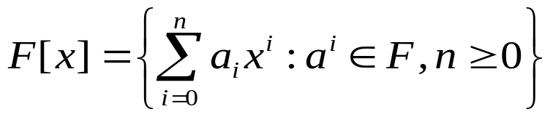
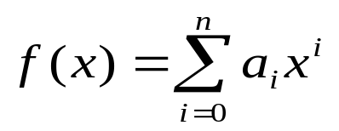
[2] Polynomial rings
Definition 3.2.1:
  is called the polynomial ring over a field F.
  deg( f(x)): for a polynomial , n is called the degree of f(x).
  deg(0) = -∞
  A nonzero polynomial is said to be monic if a_{n} = 1 .
  deg(f(x)) >0, f(x) is said to be reducible if there exist g(x), h(x), such that deg(g(x)) < deg(f(x)), deg(h(x)) < deg(f(x)) and f(x) = g(x) h(x) .
  Otherwise f(x) is said to be irreducible.

Slide 15

[2] Polynomial rings
Example 3.2.2
  f(x) = x⁴ + 2x⁶ Z₃[x] is of degree 6.
  It is reducible as f(x) = x⁴(1+2x²).
  g(x) = 1+ x+ x² Z₂[x] is of degree 2. It is irreducible since g(0) = g(1) = 1 ≠0.
  1+ x+ x³ and 1 +x² +x³ are irreducible over Z₂.

Slide 16
[2] Polynomial rings
Definition3.2.3: Let f(x) F[x], deg(f(x)) ≧1.
For any polynomial g(x) F[x], there exists a unique pair ( s(x), r(x)) with deg(r(x)) < deg(f(x)) or r(x) =0 such that g(x) = s(x)f(x) + r(x).
  r(x) is called (principal) remainder of g(x) divided by f(x), denoted by ( g(x) (mod f(x)))

Slide 17
[2] Polynomial rings
Definition 3.2.4:
  gcd(f(x), g(x)) is the monic polynomial of the highest degree which is a divisor of both f(x) and g(x).
  co-prime: if gcd( f(x), g(x)) =1
  lcm(f(x), g(x)) is the monic polynomial of the lowest degree which is a multiple of both f(x) and g(x).

Slide 18

[2] Polynomial rings
Remark 3.2.5:
  f(x)= a‧p₁(x)^{e1}…p_{n}(x)^{en}
  g(x)= b‧p₁(x)^{d1}…p_{n}(x)^{dn}
  where a, b F*, e_{i}, d_{i} ≧0 and p_{i}(x) are distinct monic irreducible polynomials.
    Such a polynomial factorization exists and is unique
    gcd ( f(x), g(x)) = p₁(x)^{min{e1,d1}}…p_{n}(x) ^{min{en,dn}}
    lcm ( f(x), g(x)) = p₁(x)^{max{e1,d1}}…p_{n}(x) ^{max{en,dn}}
  gcd ( f(x), g(x)) = u(x)f(x)+ v(x)g(x) where deg(u(x)) < deg(g(x)) and deg(v(x)) < deg(f(x)).
  If gcd (g(x), h(x)) = 1, gcd (f(x)h(x), g(x)) =gcd (f(x), g(x)).

Slide 19
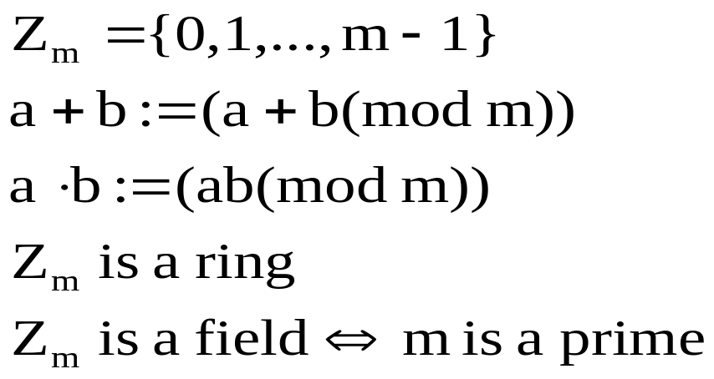
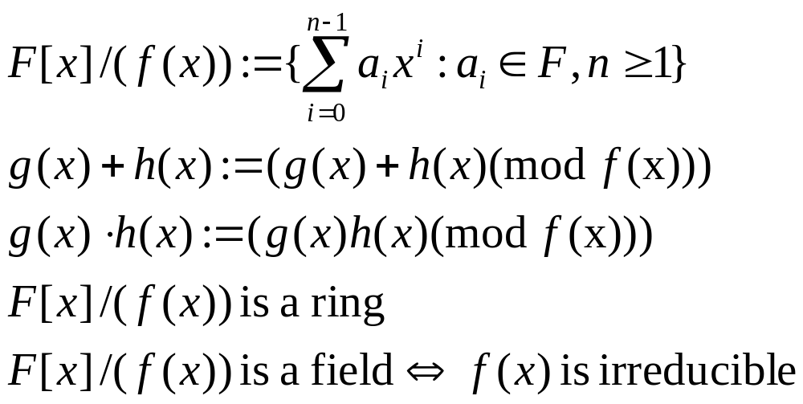
[2] Polynomial rings
Table 3.2 Analogies between Z and F[x]
  Z:
  F[x]/f(x):

Slide 20
[2] Polynomial rings
Theorem 3.2.6: Let f(x) be a polynomial over a field F of degree ≧1. Then F[x]/(f(x)), together with the addition and multiplication defined in Table 3.2 forms a ring. Furthermore, F[x]/(f(x)) is a field if and only if f(x) is irreducible.
  Proof is similar to Theorem 3.1.9
Remark:
  If f(x) is a linear polynomial, then the field F[x]/(f(x)) is the field F itself.

Slide 21

[2] Polynomial rings
Example 3.2.8:
  1+x² is irreducible over R. R[x]/(1+x²) ={a+bx : a,b R}.
  R[x]/(1+x²) C={a+bi : a, b R}
  Z₂[x]/(1+x²) = {0, 1, x, 1+x} is a ring not a field.
  Since (1+x)(1+x)=0
+ | 0 1 x 1+x
0 1 x 1+x | 0 1 x 1+x 1 0 1+x x x 1+x 0 1 1+x x 1 0
* | 0 1 x 1+x
0 1 x 1+x | 0 0 0 0 0 1 x 1+x 0 x 1 1+x 0 1+x 1+x 0

Slide 22
[2] Polynomial rings
  Z₂[x]/(1+x+x²) = {0, 1, x, 1+x} is a ring also a field.
+ | 0 1 x 1+x
0 1 x 1+x | 0 1 x 1+x 1 0 1+x x x 1+x 0 1 1+x x 1 0
* | 0 1 x 1+x
0 1 x 1+x | 0 0 0 0 0 1 x 1+x 0 x 1+x 1 0 1+x 1 x

Slide 23
[3] Structure of finite fields
Lemma 3.3.1: For every element β of a finite field F with q elements, we have β^{q} = β.
Proof:
  If β=0, then β^{q}= 0 = β.
  If β≠0, let F* = {a₁, …,a_{q-1}}. Thus, F* ={βa₁, …, βa_{q-1}}.
  a₁*a₂*…*a_{q-1} = (βa₁)*(βa₂)*…*(βa_{q-1})
  =β^{q-1}(a₁*a₂*…*a_{q-1} )
  Hence, β^{q-1}=1. β^{q}= β.

Slide 24
[3] Structure of finite fields
Lemma 3.3.2: Let F be a subfield of E with |F|=q. Then an element β of E lies in F if and only if β^{q}= β.
Proof: (➔) Lemma 3.3.1
(⬅) The polynomial x^{q}-x has at most q distinct roots in E. As all elements of F are roots of x^{q}-x and |F|=q.
F={all roots of x^{q}-x in E}.
Hence, for any β E satisfying β^{q}= β, it is a root of x^{q}-x, i.e., β lies in F.

Slide 25

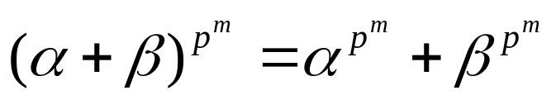
[3] Structure of finite fields
For a field F of characteristic p >0, α,β F, m≧0
For two fields E and F, the composite field E．F is the smallest field containing both E and F.

Slide 26
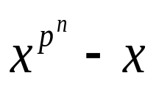
[3] Structure of finite fields
Theorem 3.3.3: For any prime p and integer n≧1, there exists an unique field of p^{n} elements.
Proof:
  (Existence) Let f(x) be an irreducible polynomial over Z_{p}. Thus, Zp[x]/f(x) is a field ( Theorem 3.2.6) of p^{n} elements (Theorem 3.1.14).
  (Uniqueness) Let E and F be two fields of p^{n} elements. In the composite field E．F, consider the polynomial over E．F. By Corollary 3.3.2, E = {all roots of } = F.
F_{q} or GF(q) denote the finite field with q elements.

Slide 27
[3] Structure of finite fields
Definition 3.3.4: An element α in a finite field F_{q} is called a primitive element (or generator) of F_{q} if F_{q} ={0, α, α², …, α^{q-1}}.
Example 3.3.5: Consider the field F₄ = F₂[x]/(1+x+x²).
x² = -(1+x) = 1+x,
x³ = x(x²) = x+x² = x+1+x = 1.
Thus, F₄ = {0, x, 1+x, 1} = {0, x, x², x³}, so x is a primitive element.

Slide 28
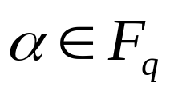
[3] Structure of finite fields
Definition 3.3.6: The order of a nonzero element
denoted by ord(α), is the smallest positive integer k such that α^{k} = 1 .
Example 3.3.7: Consider the field F₉ = F₃[x]/(1+x²).
x² = -1,
x³ = x(x²) = -x,
x⁴ = (x²)² = (-1)² = 1
∴ord(x) = 4.

Slide 29

[3] Structure of finite fields
Lemma 3.3.8:
  The order ord(α) divides q-1 for every α F*.
  For two nonzero elements α, β F*. If gcd( ord(α), ord(β))=1, then ord(αβ) = ord(α)*ord(β).

Slide 30
[3] Structure of finite fields
Proposition 3.3.9:
  A nonzero element of F_{q} is a primitive element if and only if its order is q-1.
  Every finite field has at least one primitive element.

Slide 31
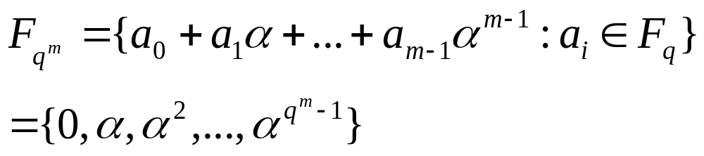
[3] Structure of finite fields
Remark 3.3.10:
  Primitive elements are not unique.
  For an irreducible polynomial f(x) of degree n over
  a field F, let α be a root of f(x). Then the field F[x]/(f(x)) can be represented as
  F[α]={a₀ +a₁α+ … +a_{n-1} α^{n-1}: a_{i} in F}
  If α is a root of an irreducible polynomial of degree m over F_{q}, and it is also a primitive element of F_{qm} = F_{q}[α].

Slide 32
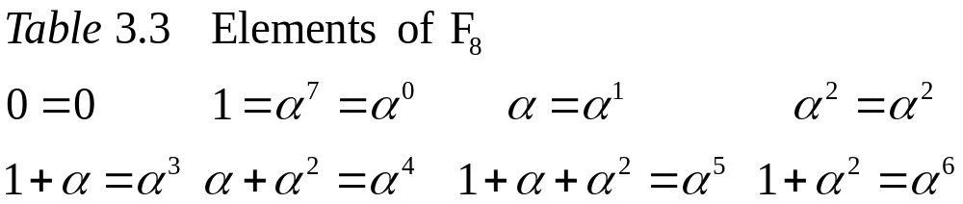
[3] Structure of finite fields
Example 3.3.11:
Let α be a root of 1+x+x³ F₂[x]. Hence F₈=F₂[α]. The order of α is a divisor of 8-1=7. Thus, ord(α)=7 and α is a primitive element.
Using Table 3.3, ex:
α³+α⁶ = (1+α)+(1+α²) = α+α² = α⁴
α³α⁶ = α⁹=α²

Slide 33
[3] Structure of finite fields
Zech’s Log table:
  Let α be a primitive element of F_{q}. For each 0≦i≦q-2 or i = ∞, we determine and tabulate z(i) such that 1+α^{i}=α^{z(i)}. (set α∞ = 0)
  For any two elements α^{i} and α^{j} with 0≦i ≦ j≦ q-2 in F_{q}.
  α^{i}+α^{j} = α^{i}(1+α^{j-i}) = α^{i+z(j-i) (mod q-1)}
  α^{i}α^{j} = α^{i+j (mod q-1)}

Slide 34
[3] Structure of finite fields
Example 3.3.12:
Let α be a root of 1+2x+x³ F₃[x].
  F₂₇=F₃[α], αis a primitive element of F₂₇.
  Using Zech’s log table (Table 3.4)
  α⁷+α¹¹= α⁷(1+α⁴) =α⁷α¹⁸ =α²⁵,
  α⁷α¹¹=α¹⁸

Slide 35
[3] Structure of finite fields
Table 3.4 Zech’s log table for F₂₇
i | z(i) | i | z(i) | i | z(i)
∞ | 0 | 8 | 15 | 17 | 20
0 | 13 | 9 | 3 | 18 | 7
1 | 9 | 10 | 6 | 19 | 23
2 | 21 | 11 | 10 | 20 | 5
3 | 1 | 12 | 2 | 21 | 12
4 | 18 | 13 | ∞ | 22 | 14
5 | 17 | 14 | 16 | 23 | 24
6 | 11 | 15 | 25 | 24 | 19
7 | 4 | 16 | 22 | 25 | 8

Slide 36
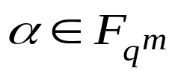

[4] Minimal polynomials
Definition 3.4.1:
A minimal polynomial of an element with respect to F_{q} is a nonzero monic polynomial f(x) of the least degree in F_{q}[x] such that f(α)=0.
Example 3.4.2:
Let α be a root of the polynomial 1+x+x² F₂[x].
∵x and 1+x are not minimal polynomials of α.
∴1+x+x² is a minimal polynomial of α.

Slide 37


[4] Minimal polynomials
Theorem 3.4.3:
  The minimal polynomial exists and is unique.
  It is also irreducible.
  If a monic irreducible polynomial M(x) F_{q}[x] has
  as a root, then it is the minimal polynomial of α with respect to F_{q}.
Example 3.4.4:
The minimal polynomial of a root of 2+x+x² F₃[x] is 2+x+x², since it is monic and irreducible.

Slide 38
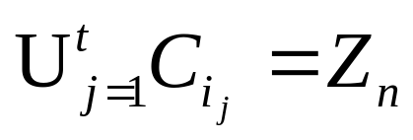
[4] Minimal polynomials
Definition 3.4.5:
Let n be co-prime to q. The cyclotomic coset of q (or q-cyclotomic coset) modulo n containing i is defined by
C_{i} = {(i．q^{j} (mod n)) Z_{n} : j= 0, 1, …}
A subset {i₁, … , i_{t}} of Z_{n} is called a complete set of representatives of cyclotomic cosets of q modulo n if C_{i1},…, C_{it} are distinct and

Slide 39
[4] Minimal polynomials
Remark 3.4.6:
  Two cyclotomic cosets are either equal or disjoint.
  i.e., the cyclotomic cosets partition Z_{n}.
  If n = q^{m}-1 for some m≧1, q^{m} ≡1 (mod q^{m}-1).
    |C_{i}| ≦ m
    |C_{i}| = m if gcd (i, q^{m}-1)=1.

Slide 40
[4] Minimal polynomials
Example 3.4.7:
The cyclotomic cosets of 2 modulo 15:
  C₀ = {0}
  C₁ = {1, 2, 4, 8}
  C₃ = {3, 6, 9, 12}
  C₅ = {5, 10}
  C₇ = {7, 11, 13, 14}
Thus, C₁ = C₂ = C₄ = C₈, and so on.
The set {0,1,3,5,7} is a complete set of representatives of cyclotomic cosets of 2 mod 15.

Slide 41
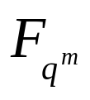
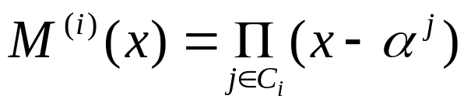
[4] Minimal polynomials
Theorem 3.4.8:
Let α be a primitive element of .
The minimal polynomial of α^{i} with respect to F_{q} is
where C_{i} is the unique cyclotomic coset of q modulo q^{m}-1 containing i.
Remark 3.4.9:
  degree of the minimal polynomial of α^{i}
  = size of the cyclomotic coset containing i.
  α^{i} and α^{k} have the same minimal polynomial
  if and only if i, k are in the same cyclotomic coset.

Slide 42
[4] Minimal polynomials
Example 3.4.10:
Let α be a root of 2+x+x² F₃[x]. F₉=F₃[α].
  C₂ = {2, 6}
  M⁽²⁾(x ) = (x-α²)(x-α⁶)
  = α⁸+(α²+α⁶)x+x²
  = 1+x²

Slide 43


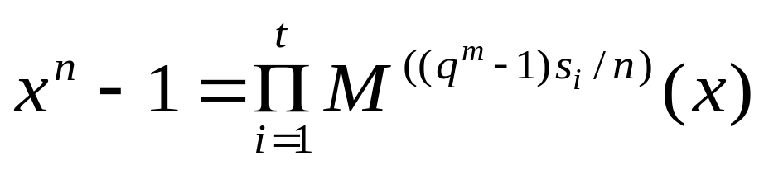
[4] Minimal polynomials
Theorem 3.4.11:
Let
  n N, gcd(q, n) =1
  m N, n|(q^{m}-1)
  α be a primitive element of
  M^{(j)}(x) be the minimal polynomial of α^{j} with respect to F_{q}
  {s₁, …, s_{t}} be a complete set of representatives of cyclotomic cosets of q modulo n
Then
  The polynomial x^{n}-1 has the factorization into monic irreducible polynomials over F_{q}:

Slide 44
[4] Minimal polynomials
Corollary 3.4.12:
Let n N, gcd(q, n) = 1.
➔ the number of monic irreducible factors of x^{n}-1 over F_{q}
= the number of cyclotomic cosets of q mod n.

Slide 45
[4] Minimal polynomials
Example 3.4.13:
  Consider x¹³ -1 over F₃.
  {0, 1, 2, 4, 7} is a complete set of representatives of cyclotomic cosets of 3 mod 13.
  Since 13|(3³-1), we consider F₂₇.
  Let α be a root of 1+2x+x³, α is also a primitive element of F₂₇.(Example 3.3.12)
  By Theorem 3.4.11,
  x¹³-1 = M⁽⁰⁾(x) M⁽²⁾(x) M⁽⁴⁾(x) M⁽⁸⁾(x) M⁽¹⁴⁾(x)

